Slide 1
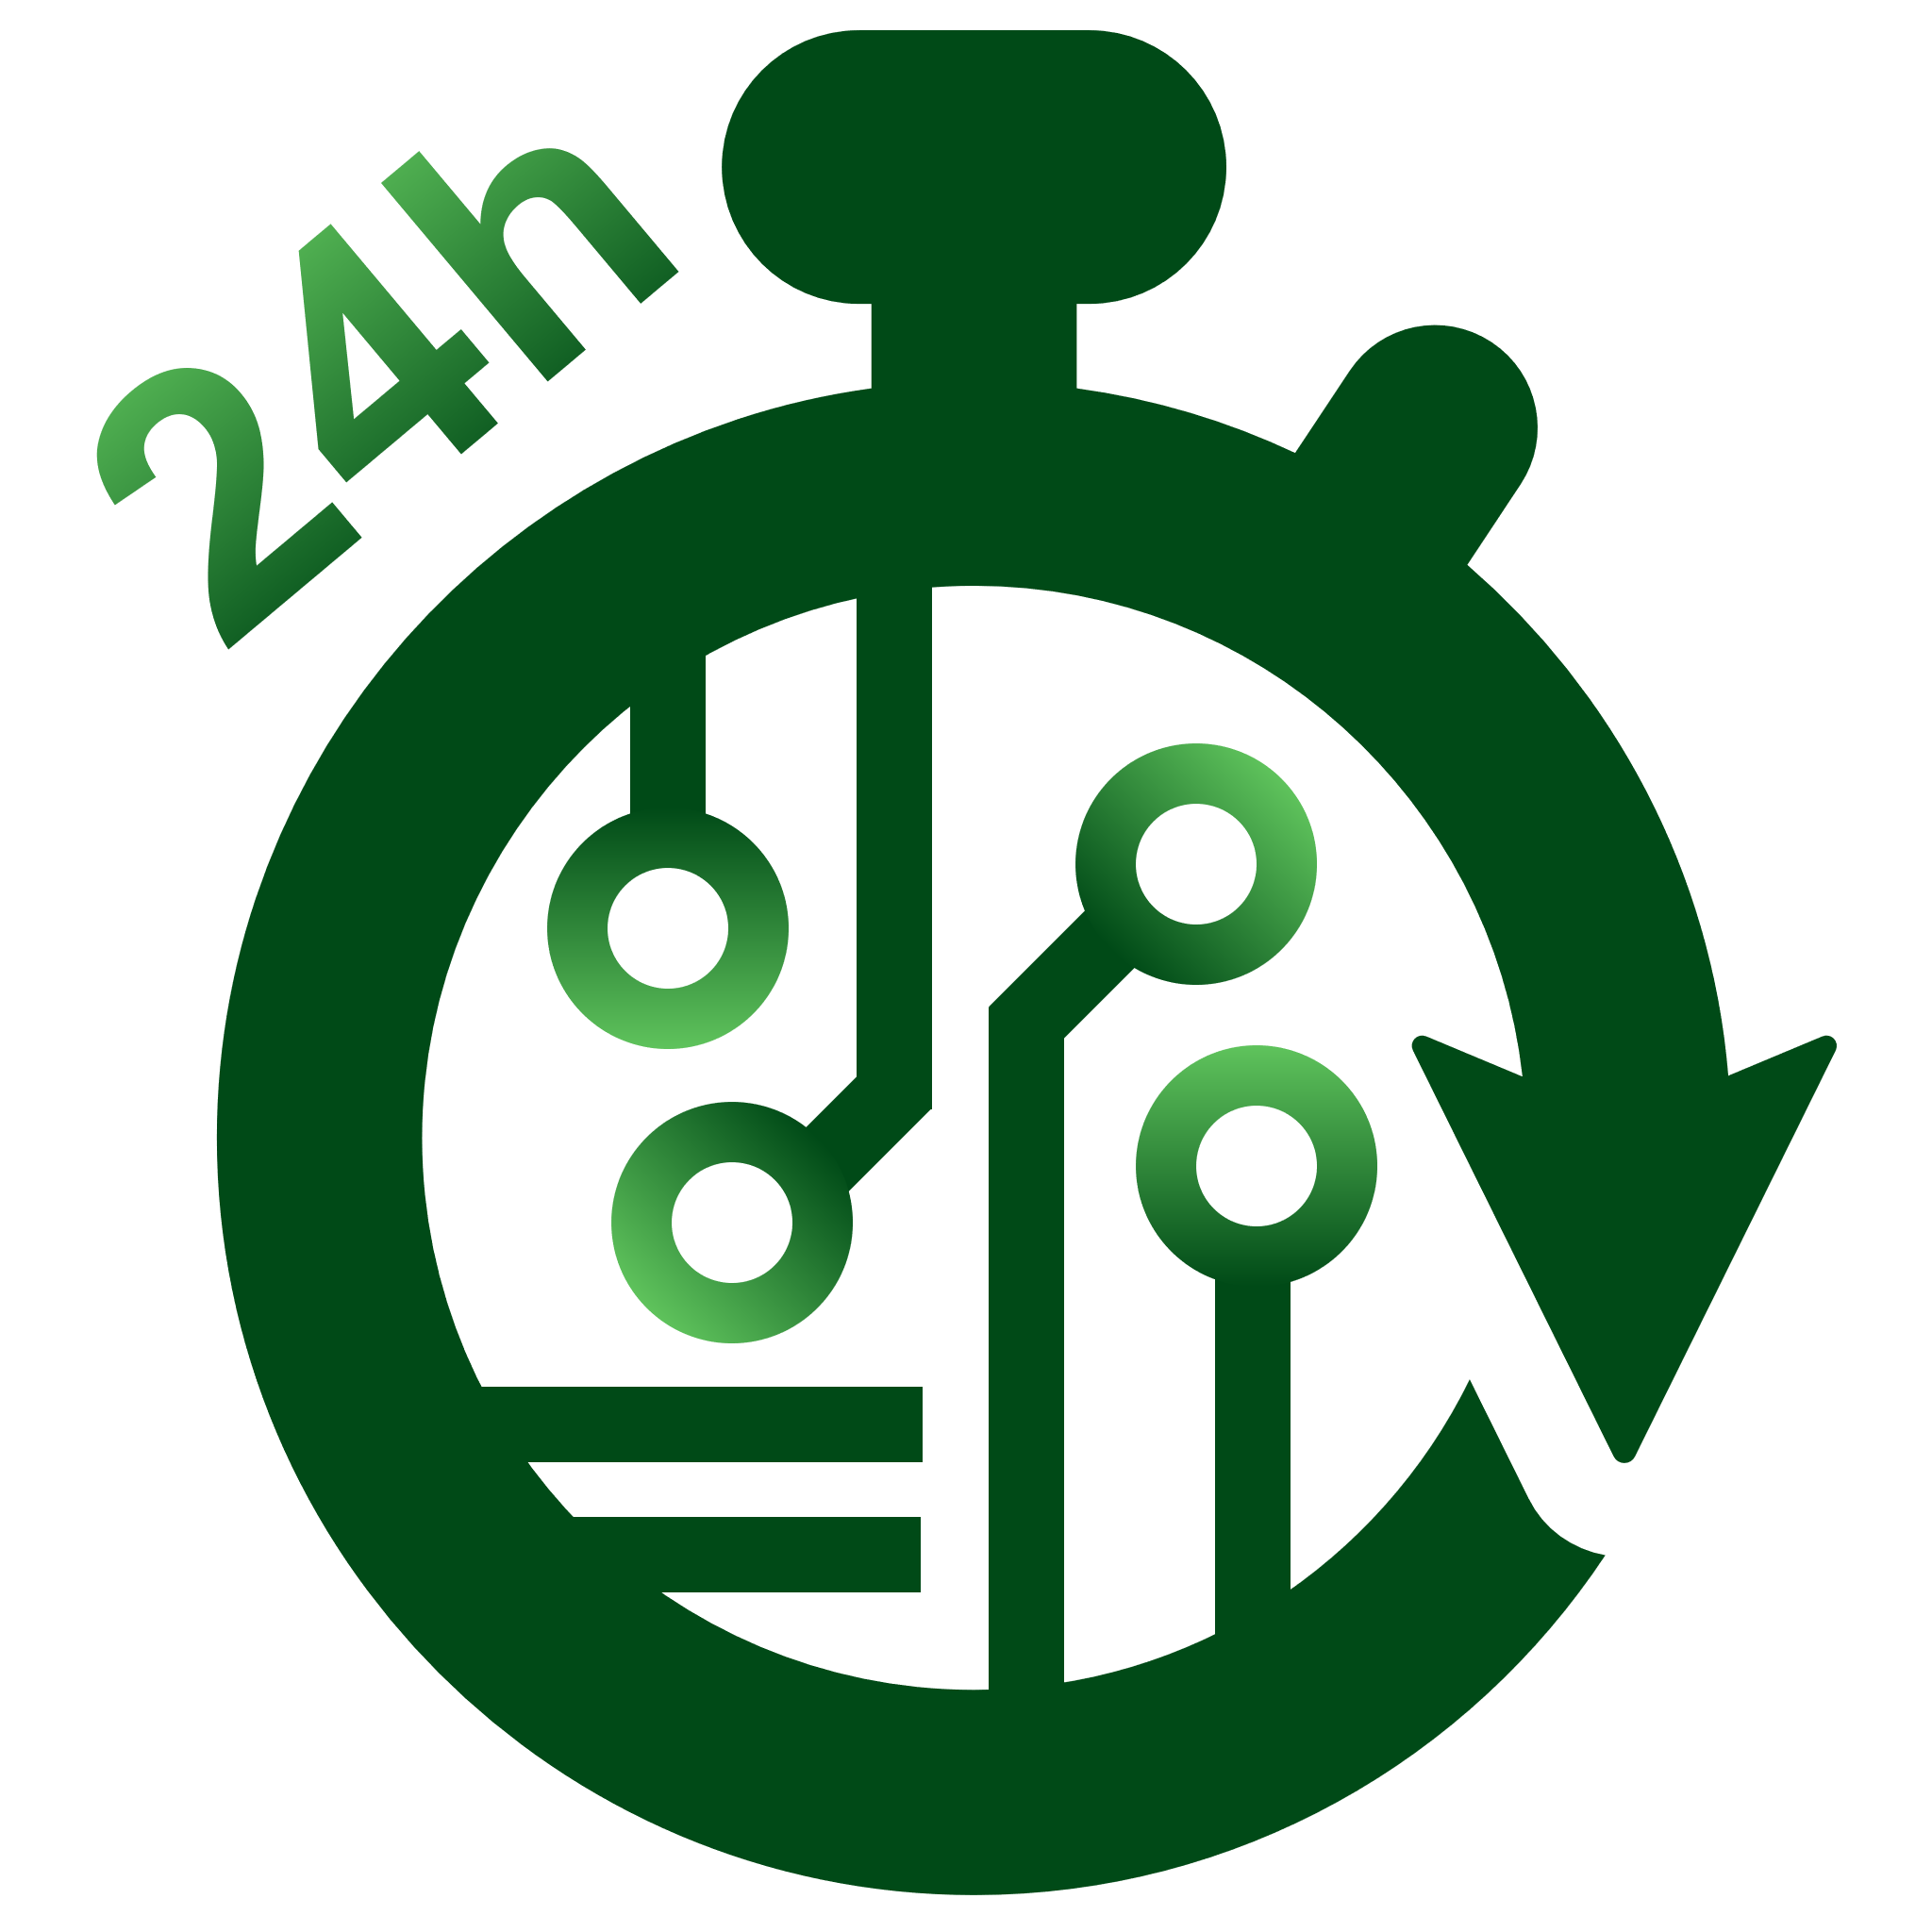
Precision Innovations Inc. www.precisioninno.com
precision
PII products and solutions based on OpenROAD provide Application Specific Integrated Circuit (ASIC) and System on Chip (SoC) design teams with an open source, no-human-in-loop, 24-hour place and route solution. It was initially developed with funding from DARPA under the Intelligent Design of Electronic Assets (IDEA) program. Precision Innovations is the primary industrial developer and is commercializing this technology.
DAC 2023
Tom Spyrou
CEO

Slide 2
Precision Innovations Overview
Company/Team Overview
Technology overview
Principal industrial developer and integrator of the OpenROAD RTL to GDS ASIC/SoC Development solution
Founded 2019
Electronic Design Automation (EDA) veterans – 10 employees / contractors
HQ – San Diego, CA.
OpenROAD is an EDA solution for hardware implementation of ASIC and SoC chips
Proven (600+ tapeouts), open source, physical design solution.
Used on designs down to 12nm
Core competency: RTL to GDS EDA flows leveraging A.I. for design space exploration and automated design implementation
A.I. based Autotuner to maximize results
ASIC and FPGA demonstrations
Fast estimation / new design feasibility analysis
Professional Support Solutions available.
History
DARPA award for OpenROAD
Key customers – Google and Intel
Partners - Siemens and GlobalFoundries

Slide 3
Positioning
For design SoC and ASIC design teams, who value time to market and who are not on the bleeding edge nodes, OpenROAD provides an open source, no-human-in-the-loop, 24-hour chip place and route solution
Unlike proprietary EDA who are focused on the bleeding edge and on designs where maximum PPA is required, regardless of the cost of tools or engineering effort, OpenROAD, provide a low cost, out of the box, push button RTL to tapeout flow
Precision Innovations is gaining traction and revenue by selling support services…
IP design houses are building test chips with OpenROAD
Others are interested in architecture exploration
Foundry private PDK support for multiple nodes.
Future SaaS offering
Precision Innovations Inc.

Slide 4
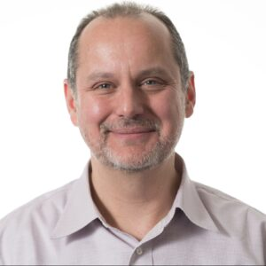
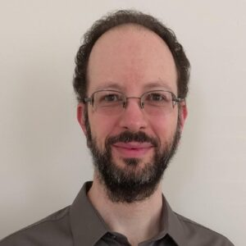
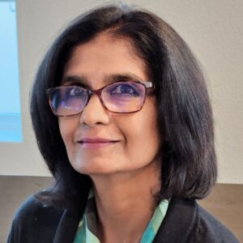
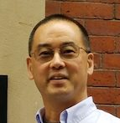
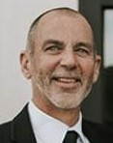
Leadership and Key Team Members
Team Member | Role | Background and Responsibilities
Tom Spyrou | President & CEO | Tom Spyrou is the CEO of Precision Innovation Inc and is the chief architect and technical program manager for the OpenROAD system. Tom is a well-known EDA system architect. He was most recently a Senior Principal Engineer in Intel’s Programmable Solutions business unit working on the Quartus FPGA compiler. Tom has worked for over 30 years as an EDA Technologist and has gained extensive experience in areas including Static Timing Analysis, Logic Synthesis, Power Grid Analysis, Database Technology and Floor-planning. He has led the development of leading-edge commercial engines and products such as PrimeTime, Voltage Storm, First Encounter, and the Open Access Database. Tom has been driving EDA algorithms to utilize parallel programming approaches with both multi-process and multi-threaded techniques. He has a BS from Carnegie Mellon University in ECE and an MS from Santa Clara University
Matt Liberty | VP Engineering | Matt Liberty is a senior developer with the OpenROAD project and Vice President of engineer for Precision Innovations. He has worked at Intel, Altera, Cadence, Synopsys, and various EDA startups. Matt has nearly thirty years of experience in EDA. Particular areas of expertise include static timing, noise analysis, RC parasitic extraction, databases, routing, GUIs, FPGAs, and software system architecture. Matt has a BSEE from University of Massachusetts at Amherst.
Indira Iyer Almeida | Business Development | Indira Iyer is an EDA expert and industry consultant at Precision Innovations (https://www.precisioninno.com/) . She is a core team member of the OpenROAD project https://theopenroadproject.org/. Her role at Precision Innovations, which is the key technology partner to OpenROAD, is to grow and expand customer engagements and outreach through key technical and strategic business development. Indira has over 25 years of global experience as a technology and business leader in the EDA, semiconductor and energy industry. She has successfully led key roles in Product and Application engineering, Product Marketing and Sales creating and managing products for ASIC/SoC digital and analog/mixed signal design flows. She performed leadership roles at major EDA companies: Siemens/EDA, Metasoftware inc, Cadence Design systems and design startups like Magma Design Automation, Monterey Design and Synfora Inc.
Andrew B. Kahng | Advisor: Distinguished Professor, UC San Diego | Andrew B. Kahng is Distinguished Professor of CSE and ECE at UCSD, where he holds the endowed chair in high-performance computing. He has been visiting scientist at Cadence (1995-97) and founder/CTO at Blaze DFM (2004-06). He is a fellow of ACM and IEEE, and was the 2019 Ho-Am Prize laureate in Engineering. He has been general chair of DAC and other conferences, and from 2000-2016 served as international chair/co-chair of the International Technology Roadmap for Semiconductors (ITRS) Design and System Drivers working groups. He is currently PI of “OpenROAD”, a U.S. DARPA project targeting open-source, autonomous (“no human in the loop”) tools for IC implementation, and PI of “TILOS”, a U.S. NSF AI Institute. Professor Kahng is the author or coauthor of several books and 500+ journal and conference papers. He holds 35 issued U. S. patents.
Tom Feist | Advisor: Embedded Entrepreneur | Tom Feist has thirty-eight years’ experience in sales, strategic marketing and business development in Cybersecurity, Electronic Design Automation and Semiconductor industries. Prior to starting 1st2Market Consulting LLC, he was a Senior Director of Marketing at Xilinx Inc. responsible for design tools, methodology, Intellectual Property (IP) and boards and kits used by over 100K systems, hardware and software engineers worldwide. Before this Feist was the VP of Marketing and Sales at AccelChip Inc. At Mentor Graphics, Inc., he was Group Director of Product Marketing, responsible for Mentor’s synthesis technologies and as Vice President of Marketing for Exemplar Logic. Prior he has served as a Product Marketing Manager, Technical Marketing Engineer, Account Manager, and Senior Field Application Engineer in the EDA industry
Precision Innovations Inc.

Slide 5
The OpenROAD Initiative 501(c)(3) Nonprofit
What is The OpenROAD Initiative www.openroadinitiative.org
A 501(c)(3) public charity for the benefit of open source EDA and related technology
Founders
Professor Andrew Kahng and Tom Spyrou
Founded Feb 2023
Goals
Continued development of OpenROAD and all open source EDA
Development of open source PDKs both manufacturable and Proxy
Creation of education material teaching chip design
Training of new EDA developers via a high quality software system
Who would contribute
Any person or organization interested in the continued development of the open design ecosystem

